Slide 1
DATA BROS
Shane Seeley and Jozef Maselek

Slide 2
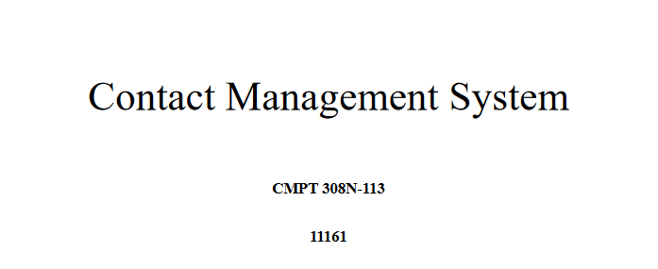

Slide 3
Outline of our system
Contact management system where users can add and interact with their contacts
Mainly meant to be at the disposal of a small company
Admins can go and manage users including adding and deleting them and can manage the system as a whole

Slide 4
Outline of our system
EACH USER SHOULD BE ABLE TO:
a. ADD MULTIPLE SETS OF CONTACT INFORMATION WITH THE FOLLOWING DETAILS: FIRST NAME, SURNAME, CELL PHONE, WORKPLACE PHONE, FAX NUMBER, EMAIL ADDRESS, GENDER, AND AGE
b. REMOVE A CONTACT RECORD
c. EDIT THE CONTACT RECORD’S DETAILS
d. SEARCH THROUGH CONTACTS BASED ON ONE OR SEVERAL FEATURES AND LIST THE RESULTS ON THE SCREEN. FOR INSTANCE, IT SHOULD BE ABLE TO RETURN THE CELL PHONE NUMBER OF A SPECIFIC NAME

Slide 5
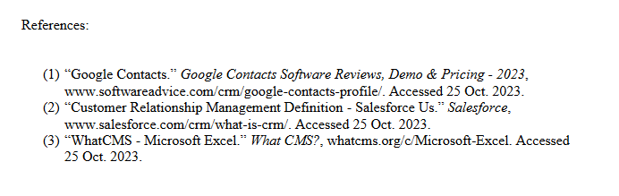

Slide 6
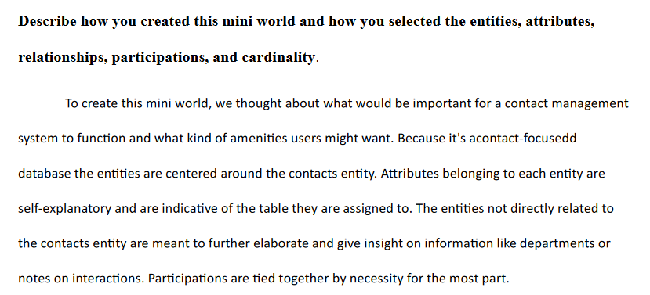

Slide 7
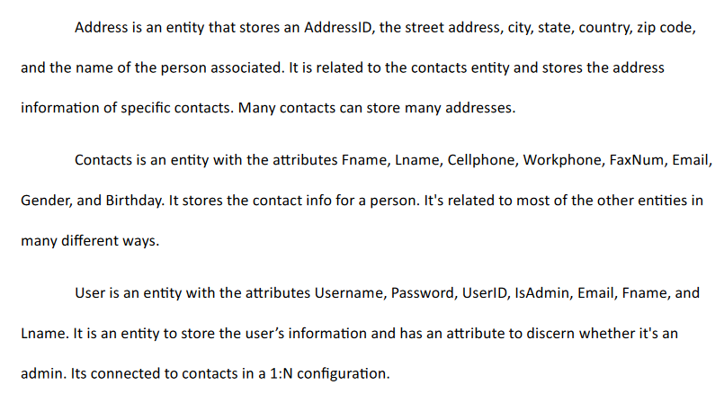

Slide 8
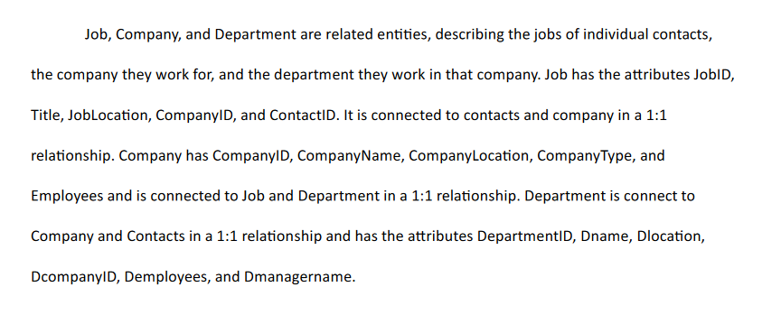

Slide 9
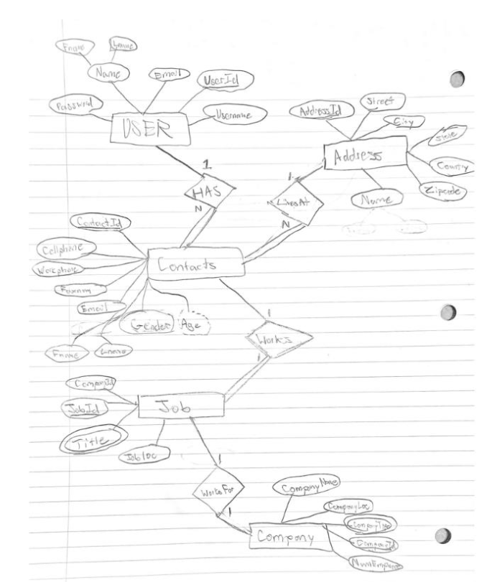

Slide 10
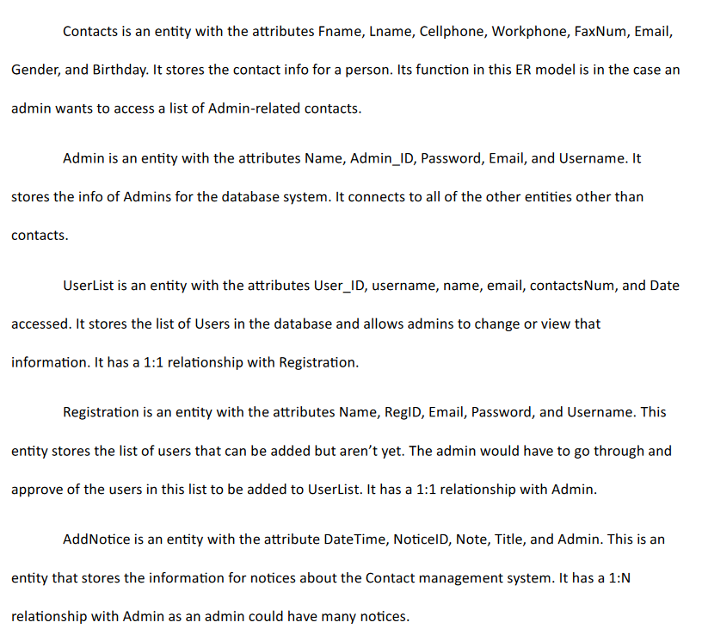

Slide 11
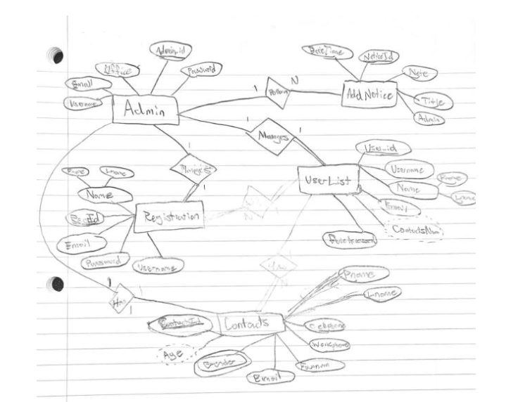

Slide 12
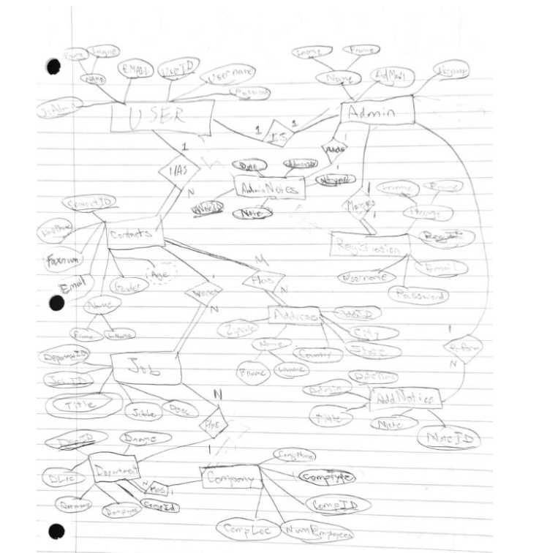

Slide 13
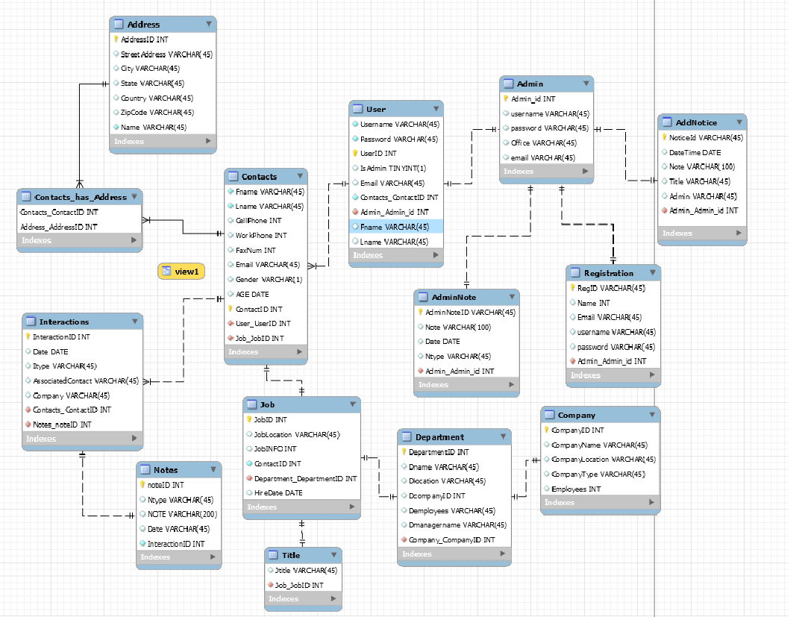

Slide 14
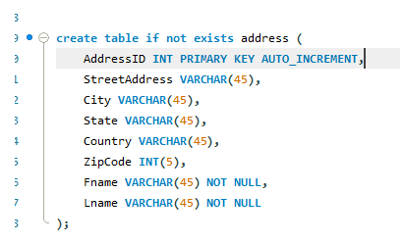
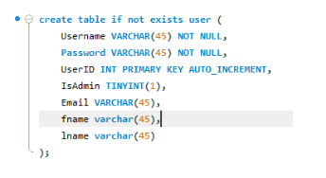
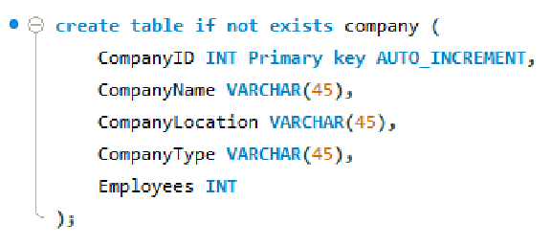
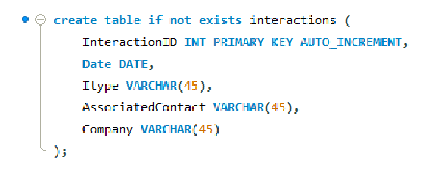

Slide 15
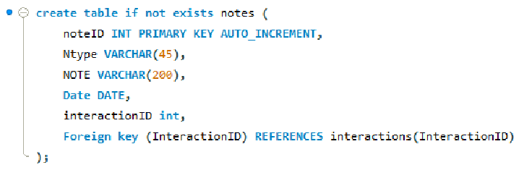
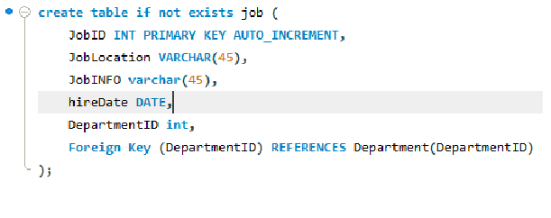
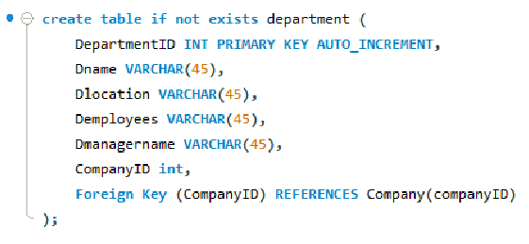
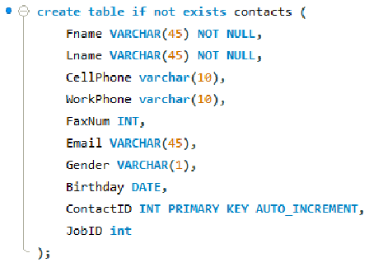

Slide 16
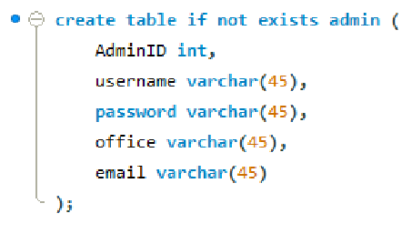
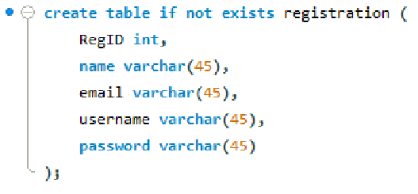
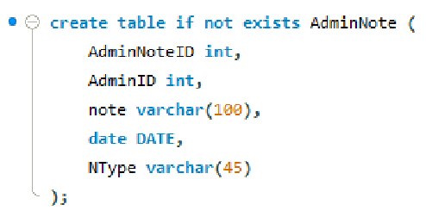
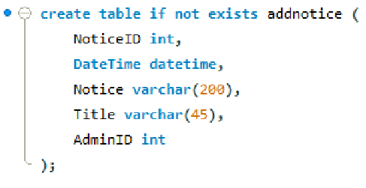

Slide 17
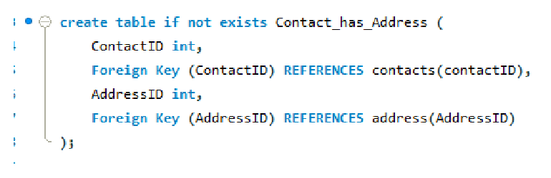
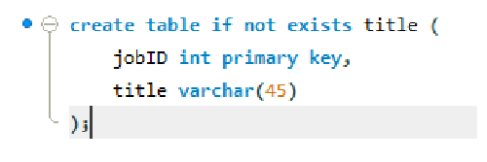

Slide 18
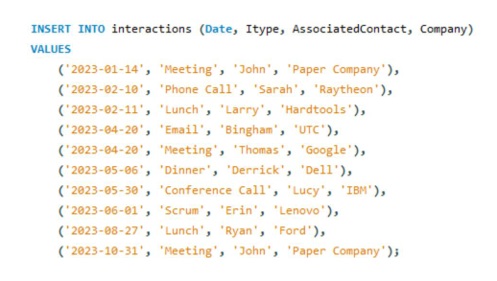
Inserting the data in one query through a multi-value insert statement, like the one shown in Figure 18, only took 0.016 sec. This applies all the data at once. Alternatively, doing a single insert statement for each piece of data takes 0.016 seconds to accomplish. To insert ten different statements would therefore take 0.16 seconds. This means that the multi-valued insert statement is 10x faster than the ten single insert statements.

Slide 19
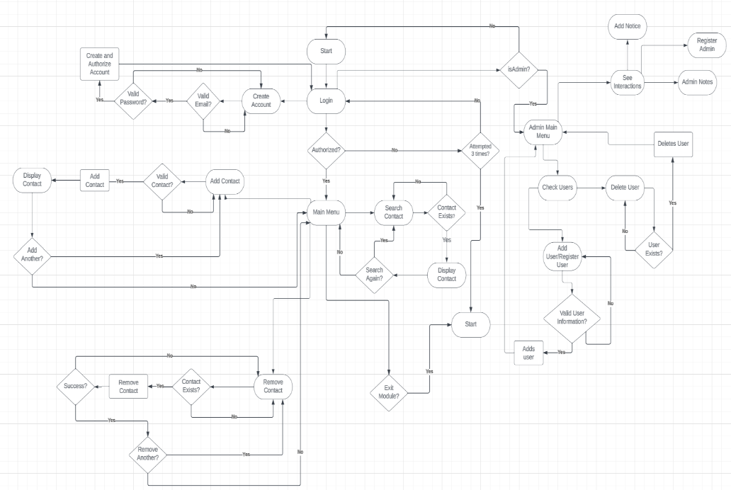

Slide 20
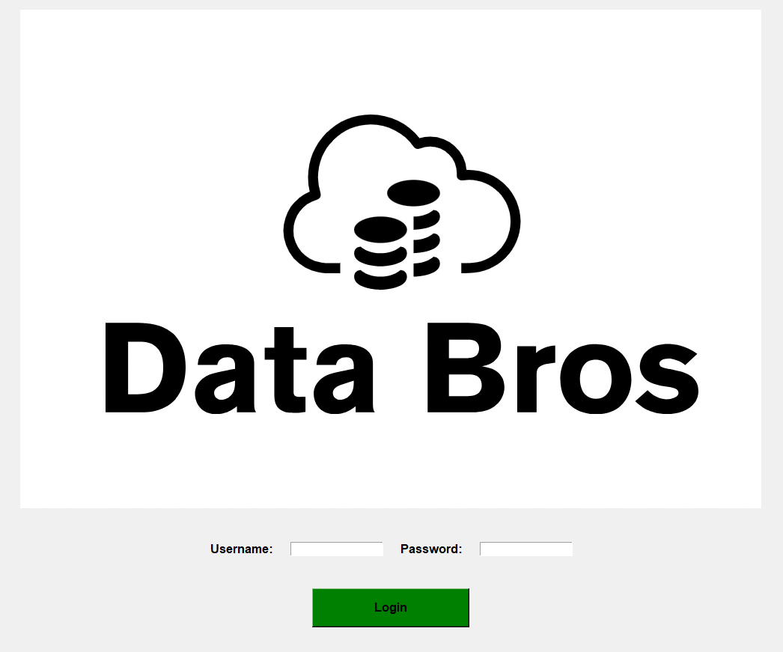

Slide 21
Thank You

